Slide 1
Working with codes in social science research: Web scraping and data analysis
Justin Yeung|Digital Text and Data Analysis

Slide 2
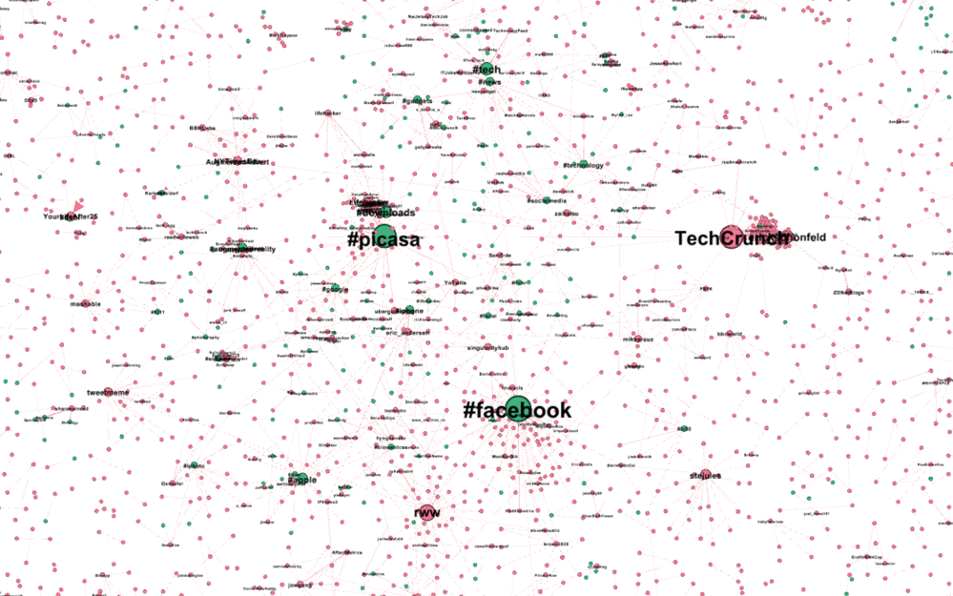
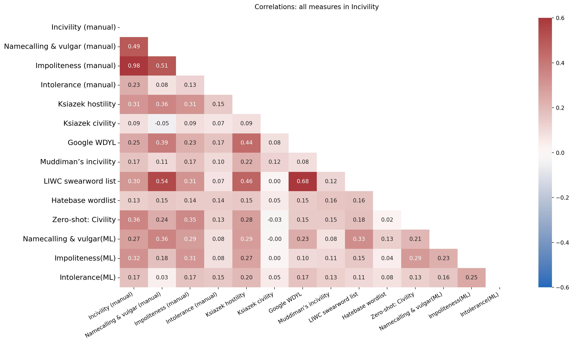
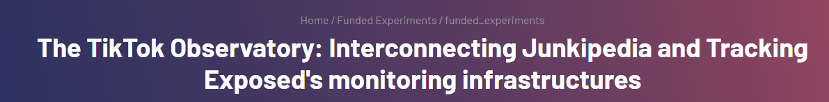
A little bit about myself
Background in communication science and computational social sciences at the University of Amsterdam
Affiliate of the Edinburgh SDS hub (you can also join!) and incoming visiting researcher at the Max Planck Institute of Human Development (Berlin)
Research topics including computational methods, algorithmic violence and news framing
Research methods including network analysis, ACA, lab / online experiments

Slide 3
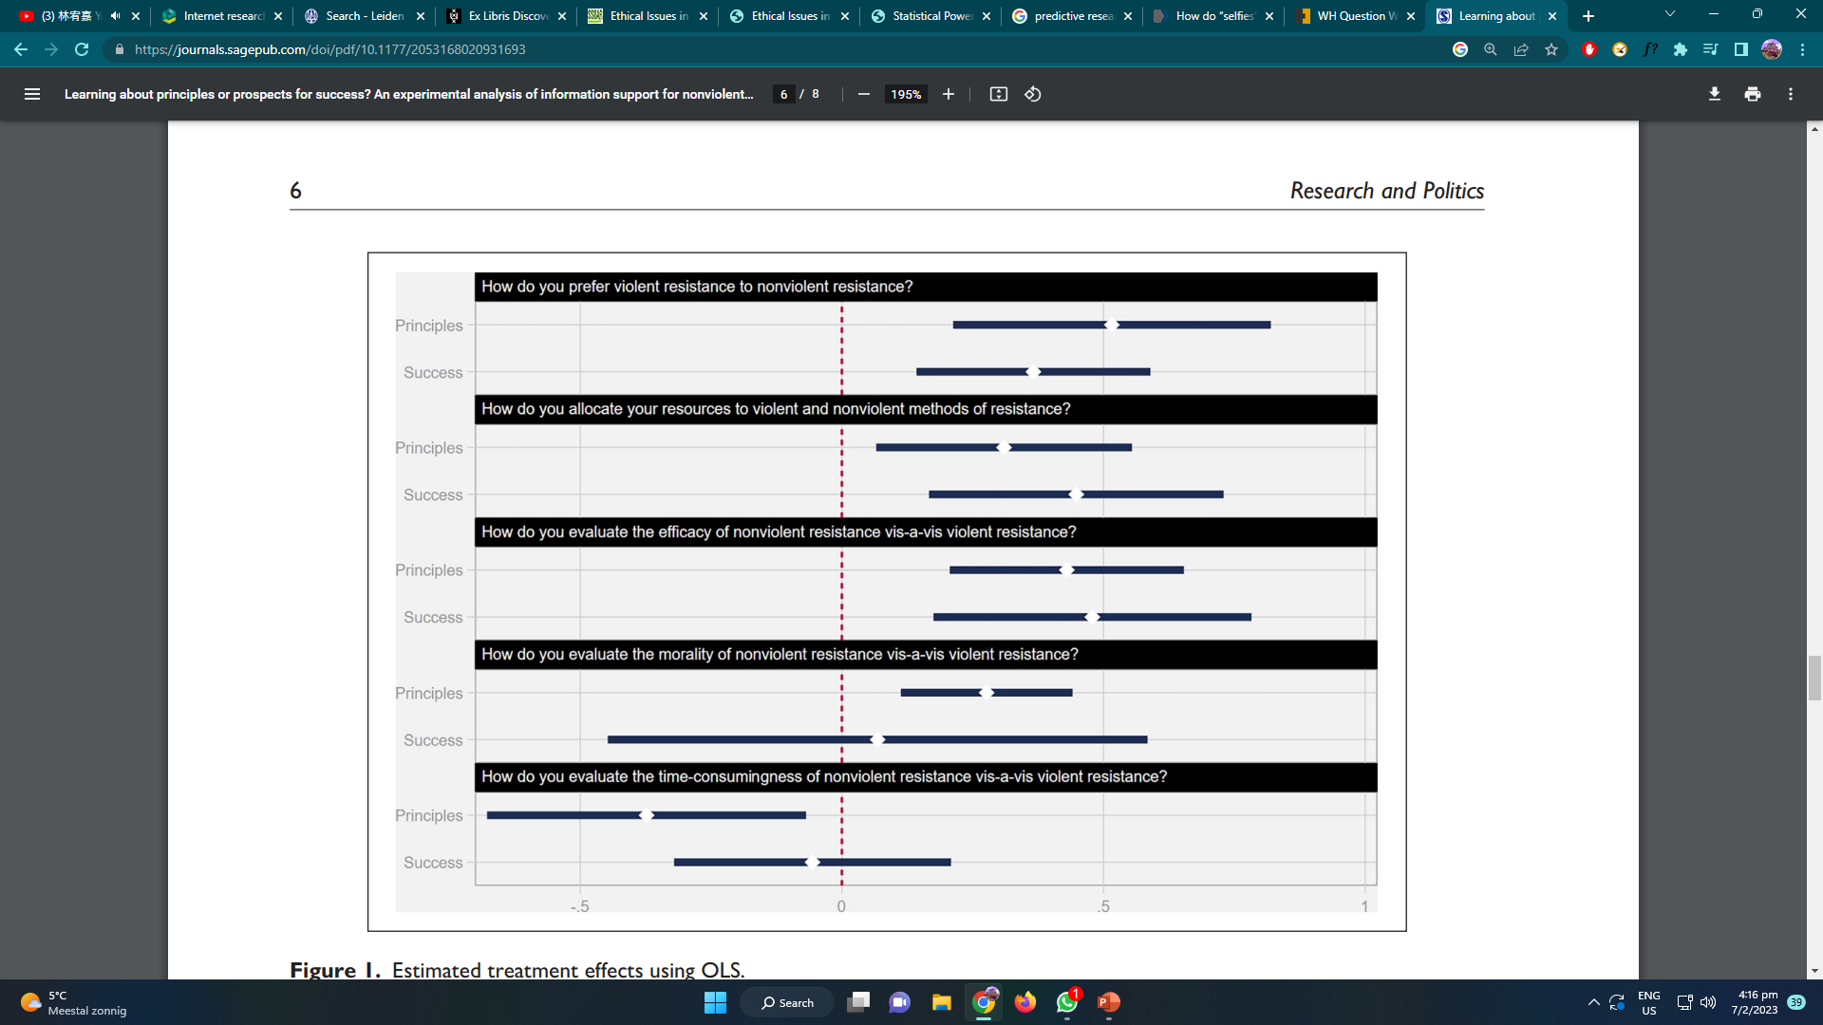
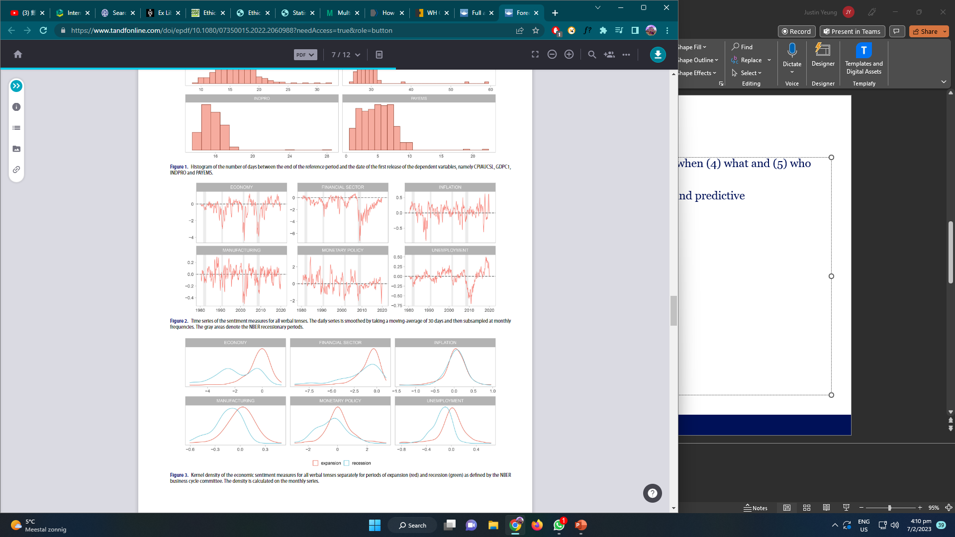
Asking questions as a social scientist
Social scientists are often interested in questions about (1) why, (2) how and (3) when (4) what and (5) who happens / behaves in certain situations
The common paradigms of social science research: Descriptive / exploratory, explanatory and predictive
Different subfields of social sciences ask different questions
Barbagliaa et al., (2022)
RezaeeDaryakenari & Asadzade (2020)
How can economic news forecast economic performance?
When do individuals tend to prefer nonviolent to violent resistance?

Slide 4

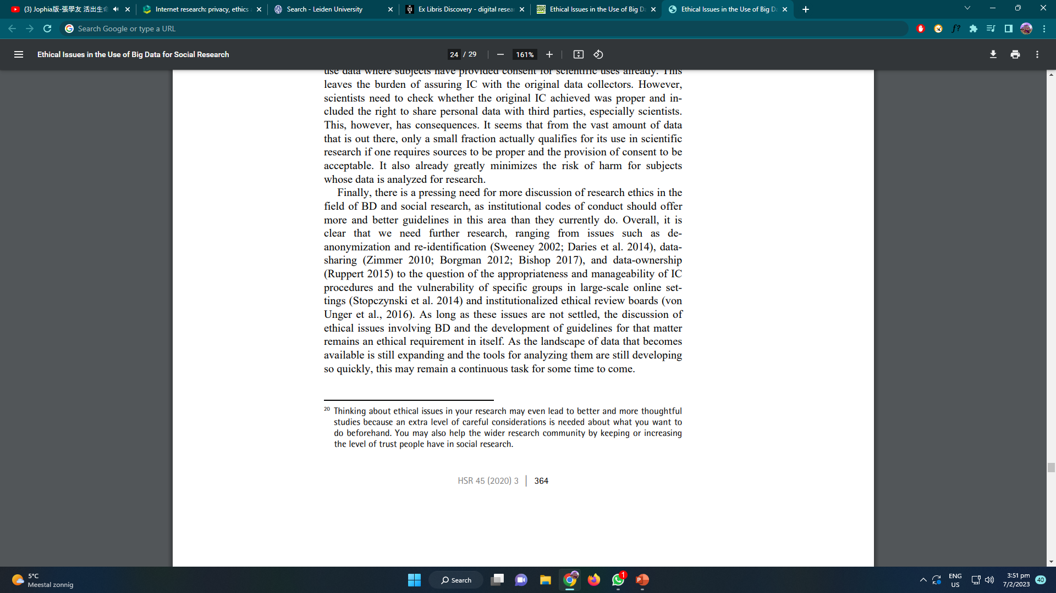
Era of ‘big’ data in the social sciences
We cannot merely collect data from surveys and (lab/online) experiments to understand our online world
We are interested in settings where external validity can be maximised
Great data come with great responsibility: research integrity and ethics
(Breur, 2016)
(Weinhardt, 2020)

Slide 5
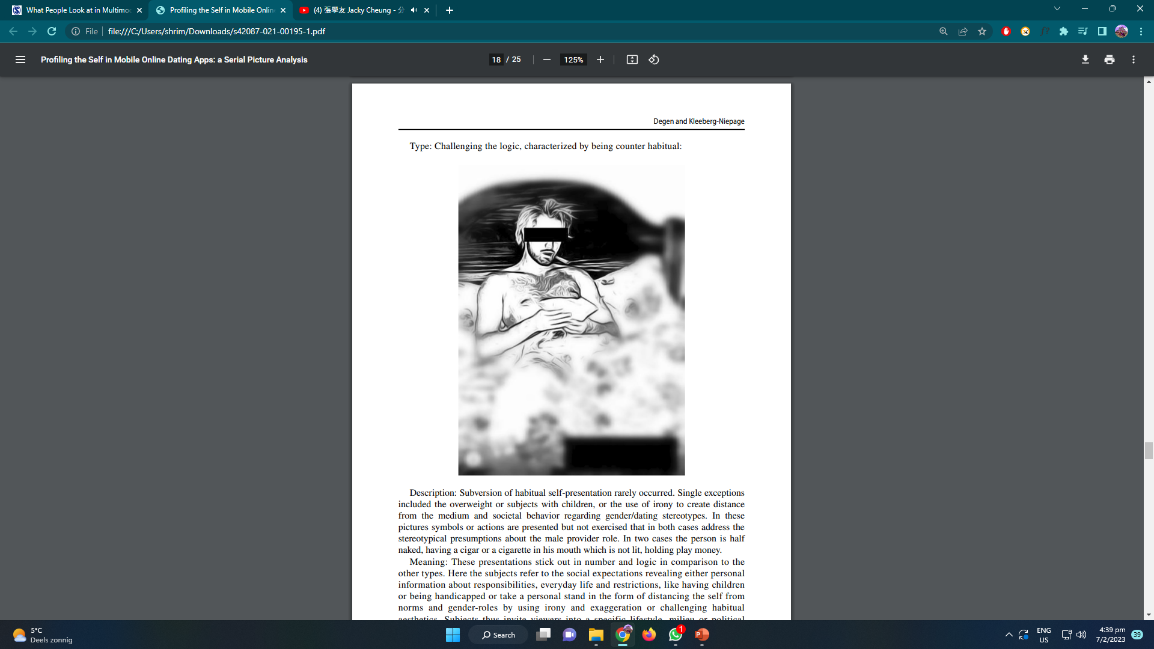
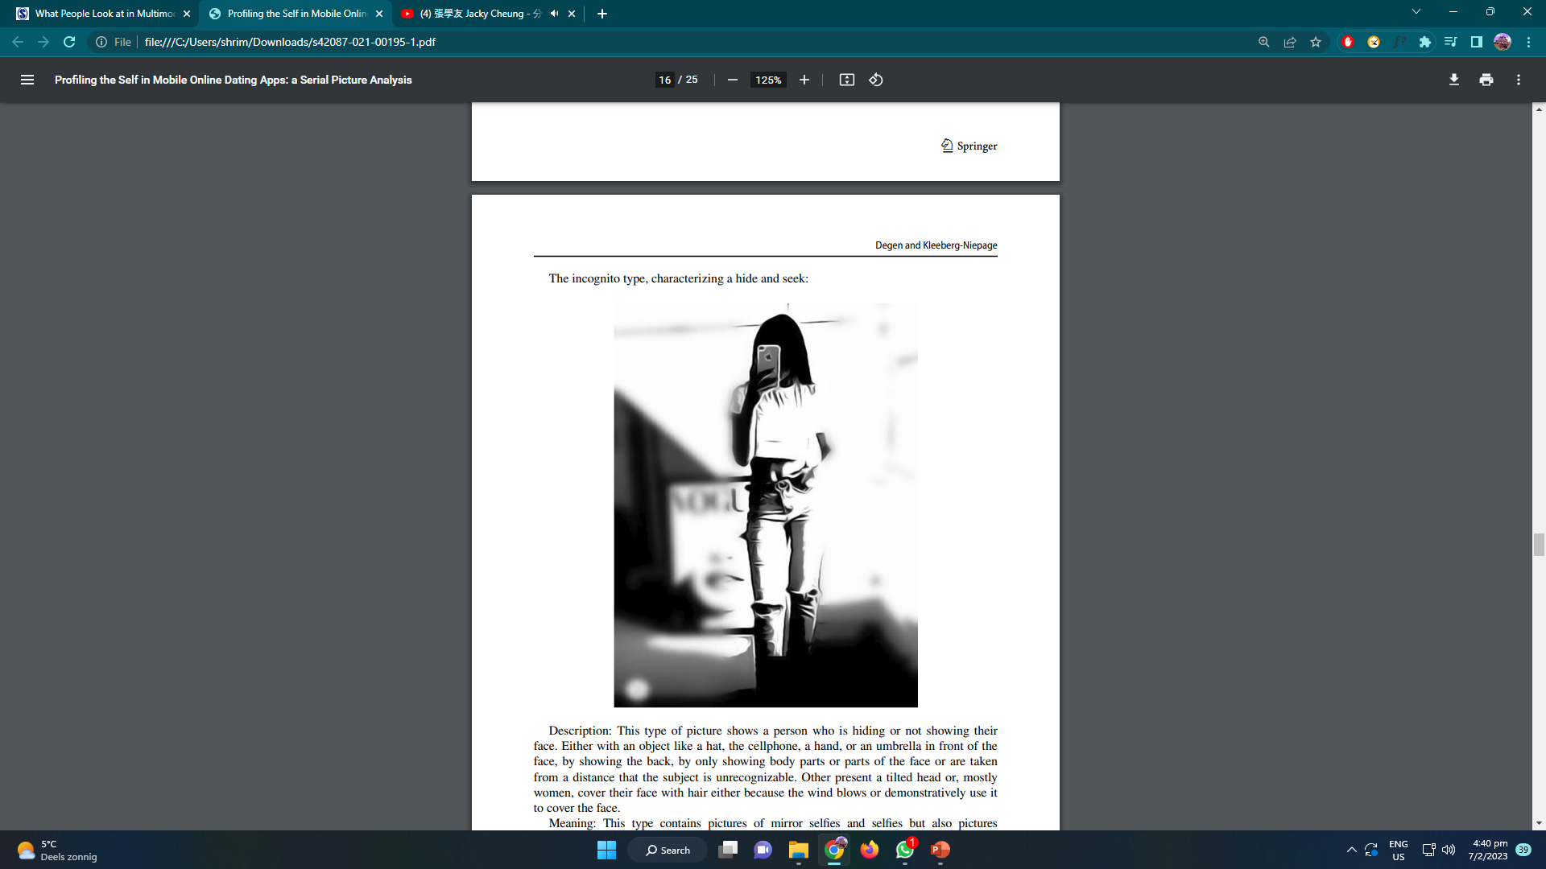
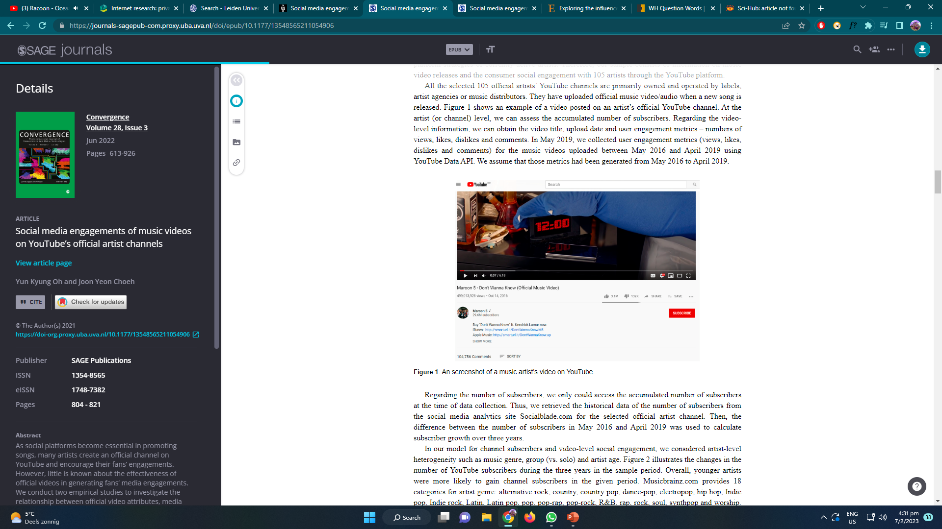
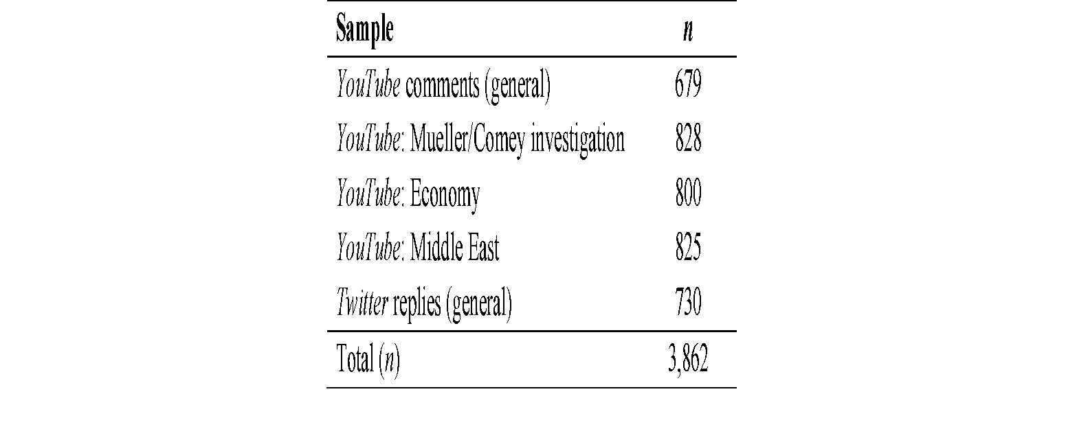
What and how to collect (digital) data?
Visual
Tinder profile pictures
(e.g., Degen & Kleeberg-Niepage, 2021)
Aural
YouTube videos
(e.g., Oh & Choeh, 2021)
Textual
Social media comments
(e.g., Boukes et al., 2022)

Slide 6
What and how to collect (digital) data?
Manual / semi-automated:
Agent-based data collection
Automated:
API and online database
Automated: API
What is / are the problem(s) ?

Slide 7


The fragile stairway to heaven: APIs for social media platforms
Application Programming Interface (API) allows for easier and technically stable access to the data available on digital platforms
Collectable data are determined by the platform’s infrastructure
Very vulnerable to the platform’s policies or management’s decisions
What can we do if API is no more available if we want to collect data from these platforms?
Source: @favstats on Twitter
Source: @danhett on Twitter

Slide 8

Building your own infrastructure!
The lazy way: Use ready-made tools such as Octoparse and ParseHub
User-friendly
Commercial
Not tailored to your research project
The good way: Create a tailored web scraper to collect your digital data with Scrapy, BeautifulSoup4 and Selenium
Difficult to set up
Open-source and free
Tailored to your research project
The common problem: Subject to platform’s changes

Slide 9
Communitarianism, diversity and social cohesion
Paradox of diversity: (ethnic) diversity will inevitably pose threats to solidarity and social capital of a society in the short-medium run but nurture a better society in the long run (Putnam, 2007).
Value of community: The values of community are necessary to balance a society too often tipped in the direction of self-centeredness, greed, and power seeking (Glass and Rud, 2012).
Community and exclusion: A thick notion of belonging will end up in forms of exclusion, which are observable from some Muslim communities in the Netherlands (Duyvendak, 2011).
A solution? Establishing an overarching communitarian blueprint – Diversity Within Unity – to uphold universal values without sacrificing diversity (Etzioni, 2002).
World
Nation
City
Neighbourhood
Family
Self
Notes:
Built on Building Cohesion in Diverse Neighbourhoods: A Perspective of Communication Infrastructure Theory (honours thesis, under supervision of Duyvendak, J.W. & Hurenkamp, M.)
Community: family, neighborhood, school, city, and beyond
Value of community: togetherness, promoting civic engagement, increasing social capital and trust
DWU: Abasic orientation that respects both the history, culture, and identity of a society and the rights of members of the society to differ on those issues that do not involve the core of basic values and universally established rights and obligations (p.19).

Slide 10
Computational social science in action
An interdisciplinary project combining communication science, sociology and urban studies
Aim
Uncover some realities in an ethno-racially mixed neighbourhood, as a manifestation of immigration and diversity
Examine why and how building a uniform and close community among various subgroups is difficult in a diverse neighbourhood.
Introducing Communication Infrastructure Theory (CIT) as a theoretical underpinning to achieve cohesion
Assessing and criticising existing platforms (i.e., NextDoor)
Our results show
Nextdoor is an underdeveloped meso-level communication infrastructure. Out of 8865 residents who age 15 or above (Statline, 2021), only 326 are participating in the respective Nextdoor page of the neighbourhood, which accounts for merely 3.68% of the population.
Our question now…
Why Nextdoor failed to establish the meso-level storytelling network in the neighbourhood?
Notes:
Built on Building Cohesion in Diverse Neighbourhoods: A Perspective of Communication Infrastructure Theory (honours thesis, under supervision of Duyvendak, J.W. & Hurenkamp, M.)

Slide 11



Communication Infrastructure as an approach to a cohesive neighbourhood
Previous literature has much focus on a macro-level policies and legal aspects to attain DWU (e.g., Baltic states: Barrington, 1999, Canada: Howard-Hassmann, 2000; Britain and France: Banton, 2001).
Communication Infrastructure Theory (CIT): a triple-level storytelling network that facilitates the construction of objective and subjective sense of belonging to a certain community (Ball-Rokeach et al., 2001).
Establishing strong community through setting common goal.
Communication infrastructures as tools to “reconstitute a social world in which the “I” and the “we” can survive” (Ball-Rokeach et al., 2001, p.393).
Example of CIs
National and local newspapers
Interpersonal networks
Macro
Meso
Micro
Notes:
Little attention has been given to how to reinforce sense of belonging and collective identity in other forms rather than top-down tools such as citizenship tests. This may not work in smaller scale and fragmented, especially ethno-racially diverse neighbourhoods.
LSV Minerva

Slide 12
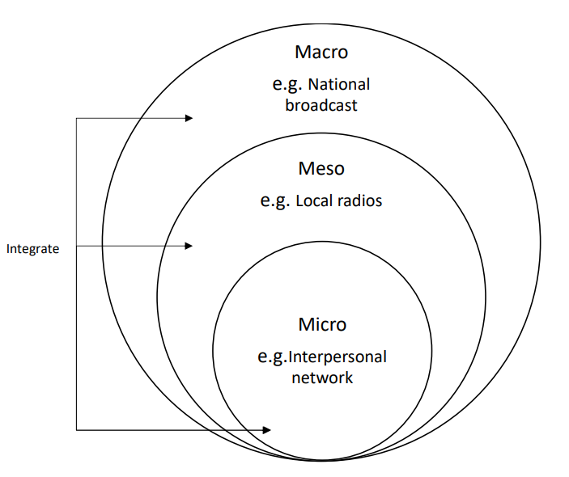
Current research on neighbourhoods and belonging
The presence and integration of CIs can strengthen sense of belonging, civic engagement and community organization connection (e.g., Choi et al., 2021; Nah et al., 2021)
Meso-level networks work better in dominantly black neighbourhoods (only in the U.S.)
Interesting moderators: commuting time, home identification and home ownership
Can the implementation of meso-level communication infrastructures encourage neighbourhood engagement?

Slide 13

Studying Nextdoor as a communication infrastructure
Nextdoor is a hyperlocal social networking site (SNS) that allows co-residents to share relevant information to a specific neighbourhood.
Nextdoor is both a meso- and micro-level infrastructure.
Nextdoor allows exclusively relevant agencies (i.e., neighbours) and information to penetrate the network
Individuals are able to connect with each other (i.e., friending) and post updates within the certain (i.e., following and posting).
What do people do / say on Nextdoor?
receive trusted information
give and get help
get things done
build real-world connections with those nearby — neighbors, businesses, and public services

Slide 14
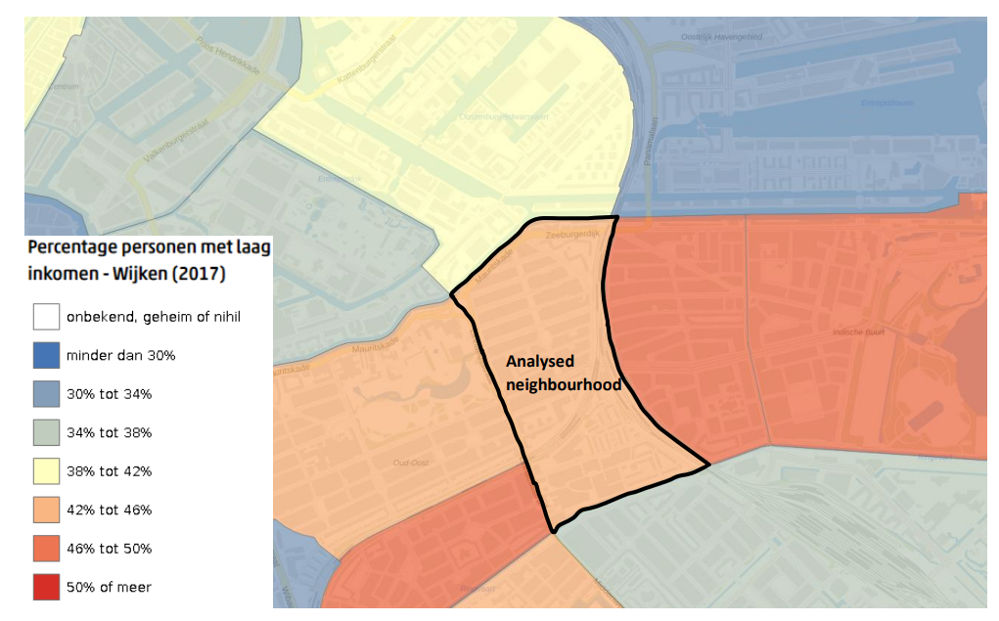
Sampling and manual content analysis
Agent-based data collection
Data collected in a neighbourhood located in Amsterdam Oost
Collected 30 consecutive posts on the news feed
Included comments
N_{total} = 119
Thematic analysis (Shanahan, 2019)
Data familiarisation
Code creation
Alignment with RQ
Theme categorisation and reviewing
Theme naming
Yeung, 2021

Slide 15

Results (Thematic analysis)
Category | Example | Count
Self-introduction | “It’s great to be here. I’m [name] … and I come from [place]. Me and my husband recently moved to the [neighbourhood] and love the area already! Looking forward to discover more and more about the neighbourhood. | 9
Ask for help / Provide help | “Urgent Alert. Has anyone seen this kitten before? Send me a message ASAP!! It is urgent, a small and orange kitten.” | 15
Community events | “Neighbourhood tour through [neighbourhood] on Sunday 26 September!” | 3
Businesses | “Dear neighbours! It is lucky, we are open! … Come thrift at [company] and spread the words!” | 1
* Original comments and posts are in Dutch
Notes:
An interesting post
A business owner as well as a resident of the neighbourhood
The post itself generated almost 30% of the comments out of the whole sample

Slide 16
Did Nextdoor failed? Some background of the neighbourhood
Out of 8865 residents who age 15 or above (Statline, 2021), only 326 are participating in the respective Nextdoor page of the neighbourhood, which accounts for merely 3.68% of the population.
Half of the households of the neighbours fall into the category of low-income and mid-to-low education household.
80% of the properties in the studied neighbourhood are rental
> Amsterdam grand mean of 68.5% (Amsterdamse Federatie van Woningcorporaties, 2020)
Some of the rental apartments are social housing.

Slide 17
So what could have been the problem(s)?
Reciprocal relationship between civic engagement and storytelling network (Liu et al., 2018).
Low % of home ownership lead to weak place attachment and sense of belonging – (La Grange & Yip, 2001; Elliott & Wadley, 2013; Leviten-Reid & Matthew, 2018).
Digital divide in Amsterdam (Goedhart & Dedding, 2020)
Internet access is hugely determined by socio-economic factors such as age, education level and income (Friemel, 2014)
Complex digital divide in Amsterdam particularly for those who live under poverty and vulnerability

Slide 18


How do we test the hypotheses?
First – we need to have a larger dataset for greater statistical power
We should collect more data and also a more diverse dataset
Data from other neighbourhoods to be able to compare means
Next, what other variables can we think about?
Home ownership rate
Education level
Age (how should we code it?)
Income
Population
…
Finally, is our study…
Quasi-experimental / nonexperimental?
Causal / Correlational?
To keep it simple, we assume that there are no omitted variables

Slide 19
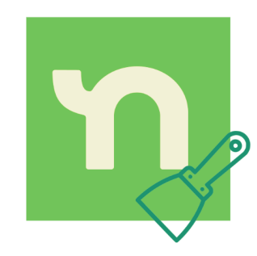
But before we start with the analysis
How do we collect the data?

Slide 20
NextDoorScraper

Slide 21
Three directions of study
Text (with VoyantTools or Python)
Question: What are the most frequently mentioned words / noun chunks on Nextdoor?
Recommended visualisation: Wordcloud / Frequency bar plot
Socio-economic factors and engagement (with Excel or Python)
Question: Do users in neighbourhoods with higher socio-economic status interact more than those in lower ones?
Challenge: Can neighbourhood average income, population and home ownership predict platform engagement?
Recommended visualisation: Regression or correlation plot / heatmap (confusion matrix)
Tip: Think about how you define platform engagement
Text + socio-economic (with Python / Excel, for more advanced students)
Question: Do neighbourhoods with a higher average income level talk more about X,Y,Z…?’
Free choice

Slide 22
Datasets
You do not have to do it yourself
Datasets have been uploaded to the designated GitHub classroom
Not all datasets have been cleaned and therefore you should check before you work on these datasets
Tip: Be careful while importing CSV files because there are ‘weird’ characters (e.g., emojis)
If you want to play with some other datasets, it is also fine
Keep in mind that you are humanists and social scientists: there should be a theoretical basis why these datasets should be used

Slide 23

Your results and conclusions?

Slide 24
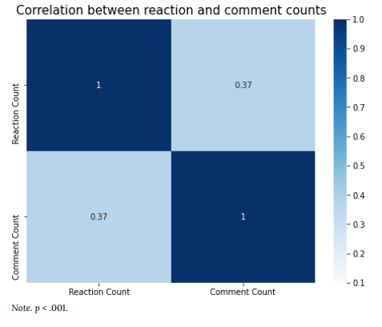
My results: Correlation between reaction and comment counts

Slide 25
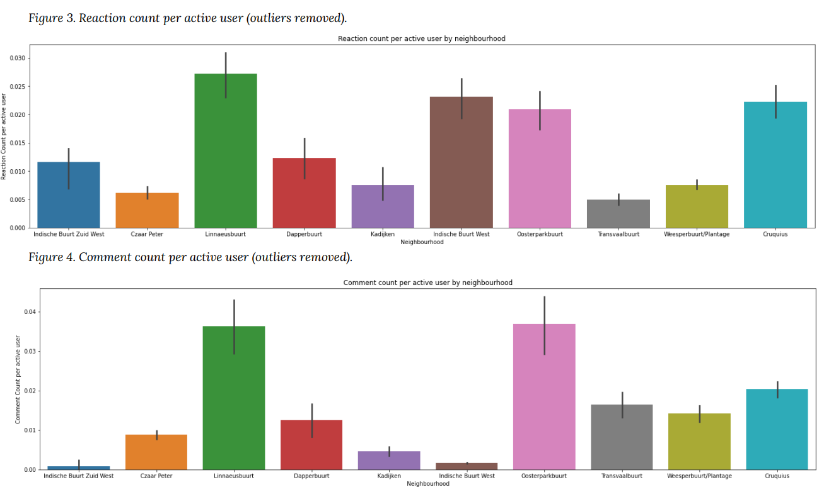
User activities

Slide 26
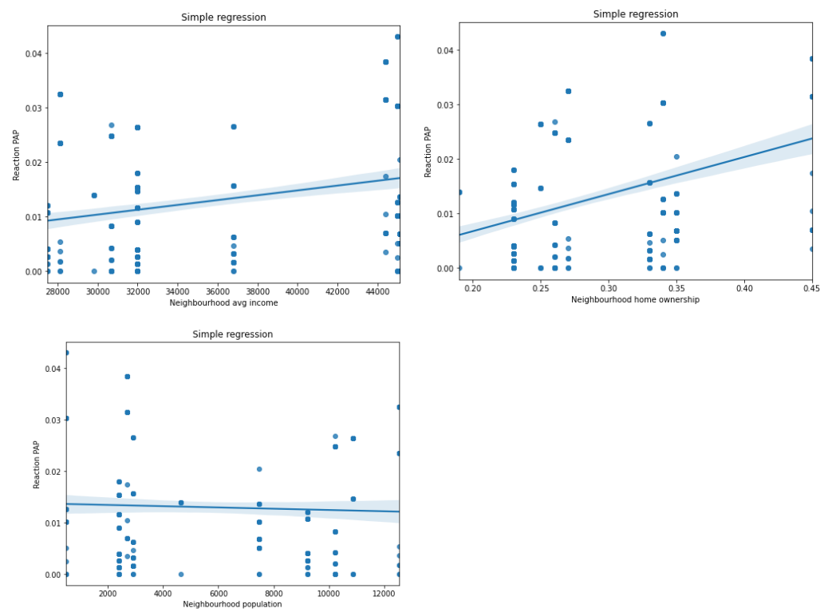
Socio-economic factors and user activities
Altogether, neighbourhood average income, population and home ownership predicts 17.3% of the variance of the outcome variable reaction count per active user, p > .001, F (453, 3) = 31.50. Both home ownership and average income could significantly predict the number of reaction count per active user, whereas neighbourhood population could not significantly predict the number of reaction count.

Slide 27
Conclusion & Future steps?
It appears that home ownership is consistently an important predictor of user engagement on NextDoor, while income can only predict reaction count but not comment count.
If home ownership plays an important role in encouraging social media engagement, can we rely on hyperlocal social media to promote cohesion (through enhancing civic engagement and trust) in socially disadvantaged neighbourhoods?
Interestingly, population does not play a role in influencing the number of user engagement
We must be cautious in making a causal claim: This is not a strictly controlled and randomly assigned study
Multilevel model may be more useful in analysing nested, hierarchical data (neighbourhood -> user)
Future steps: Gather more info from different neighbourhoods and combine the data with experimental study?

Slide 28
Thank You and Have Fun in the Digital World!

